Slide 1
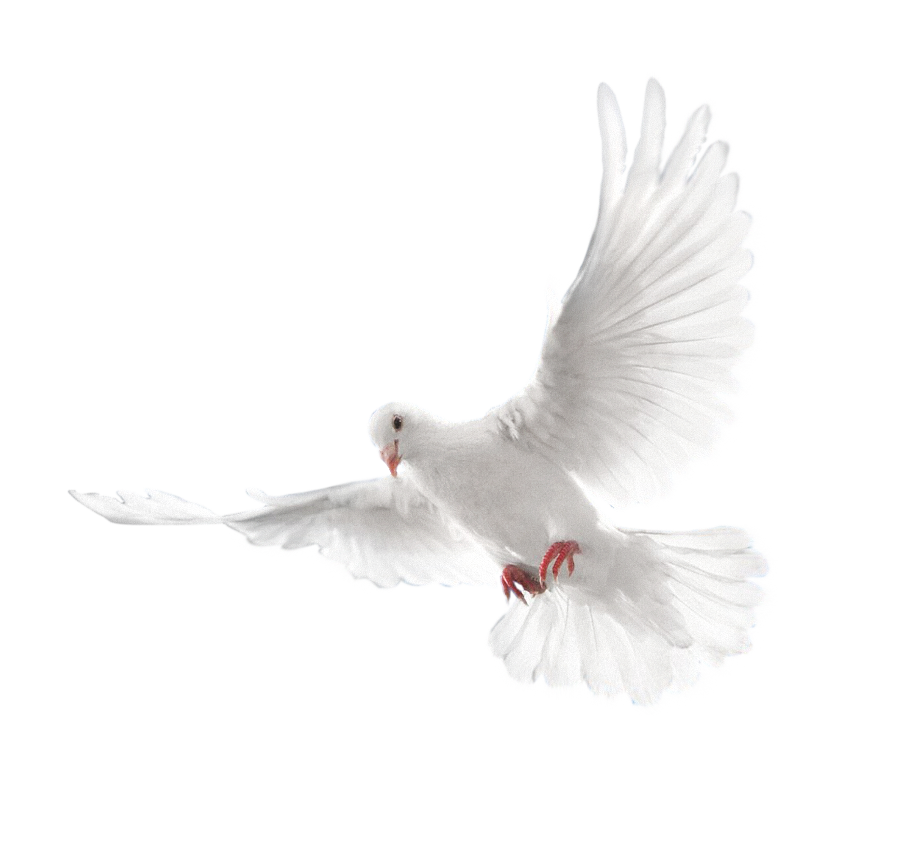
A Photo Story
memorable Times in the life of Deaconess Valeria Fields Seward

Slide 2
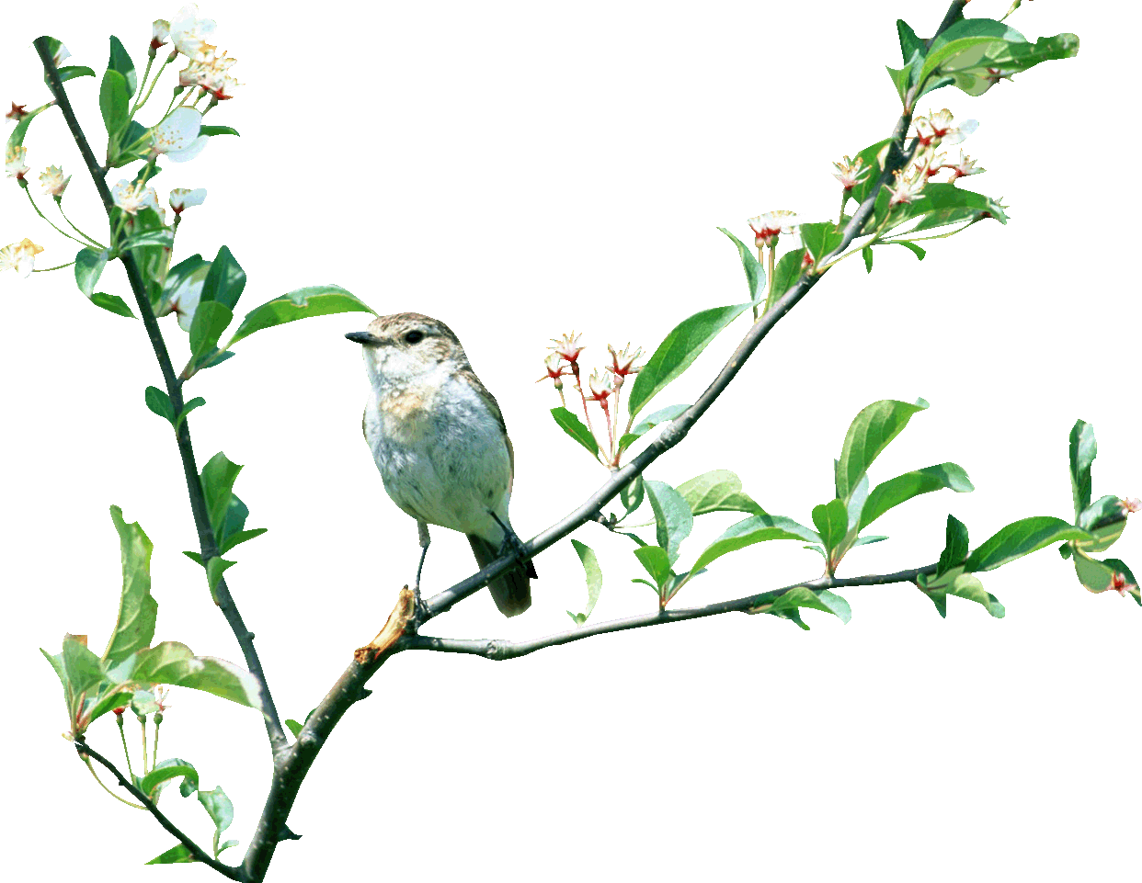
It’s Me Young and Innocent

Slide 3
On-the-Job New York - 1960 (Child Care Center)

Slide 4
Surprise!! I wasn’t expecting that one

Slide 5
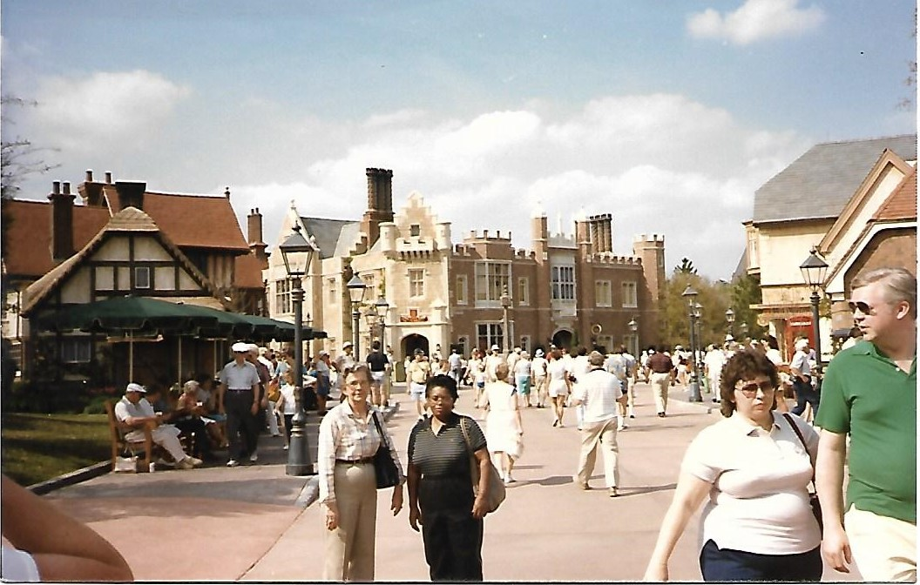
vacating in Florida March 1985

Slide 6
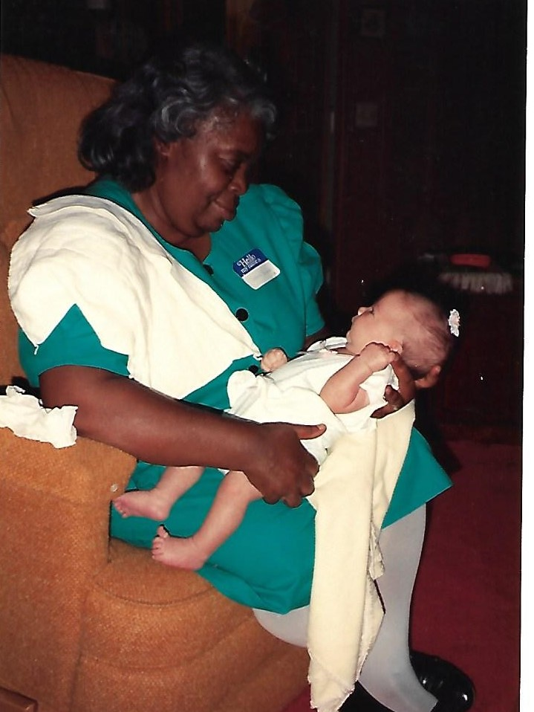
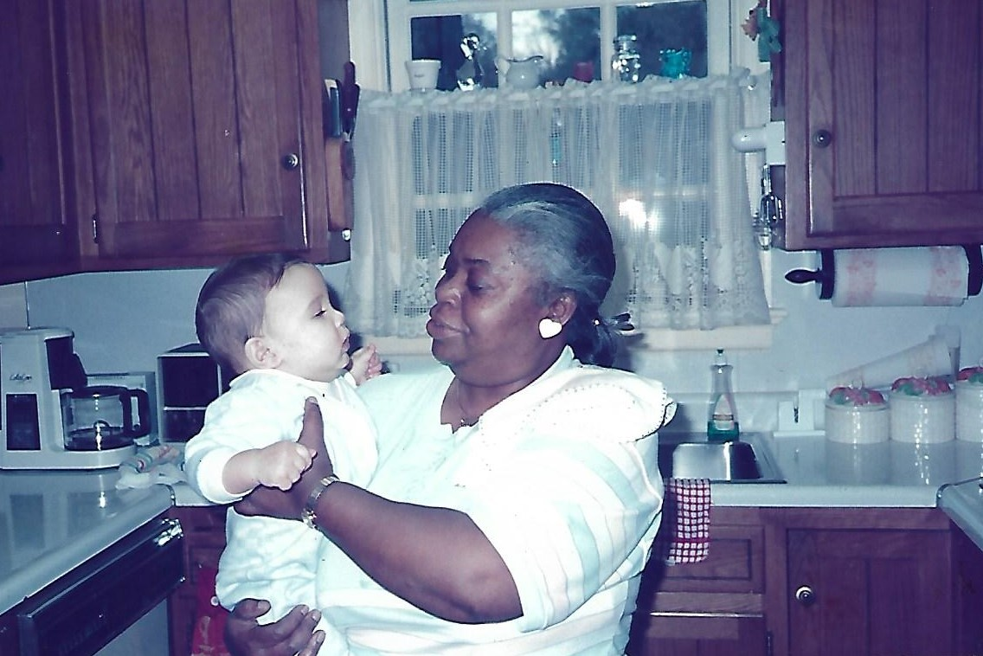
Live-in homecare/childcare Lucy’s Family Home (1980-1990’s)

Slide 7
Wedding Day August 1989

Slide 8
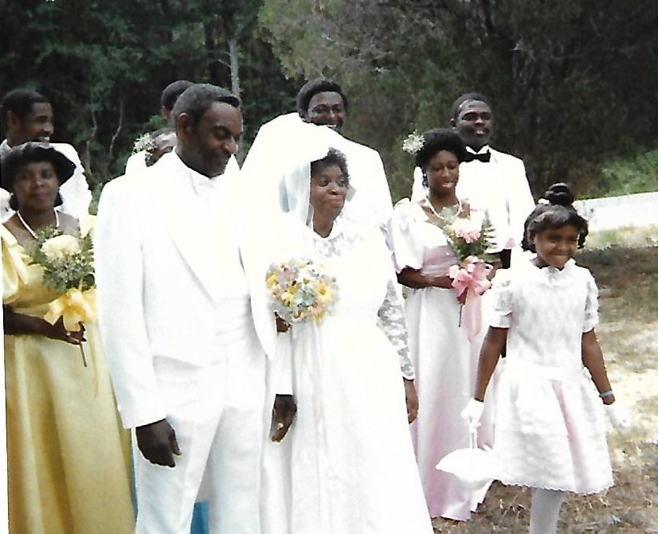
Wedding party

Slide 9
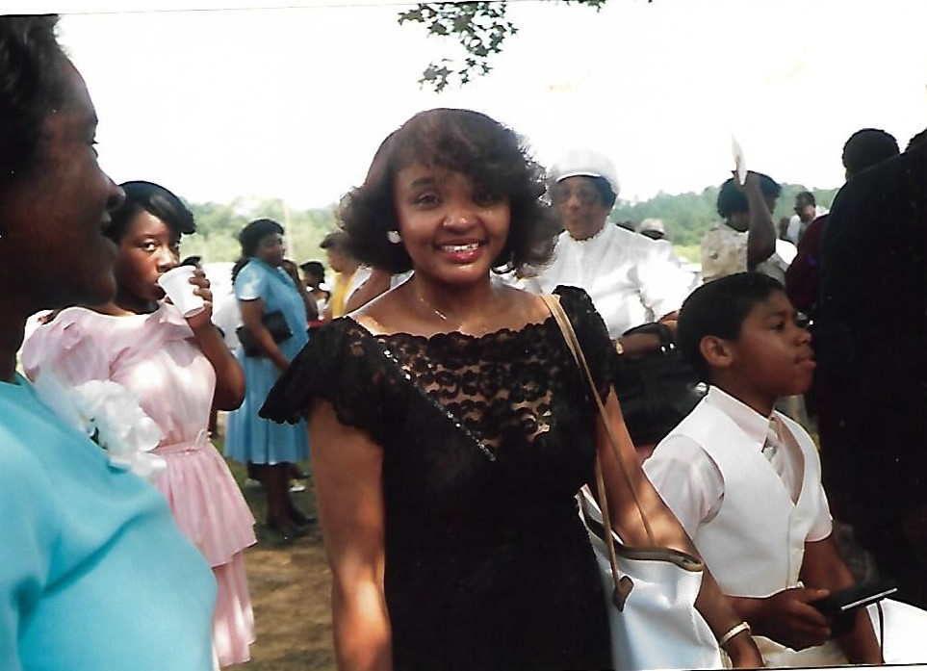
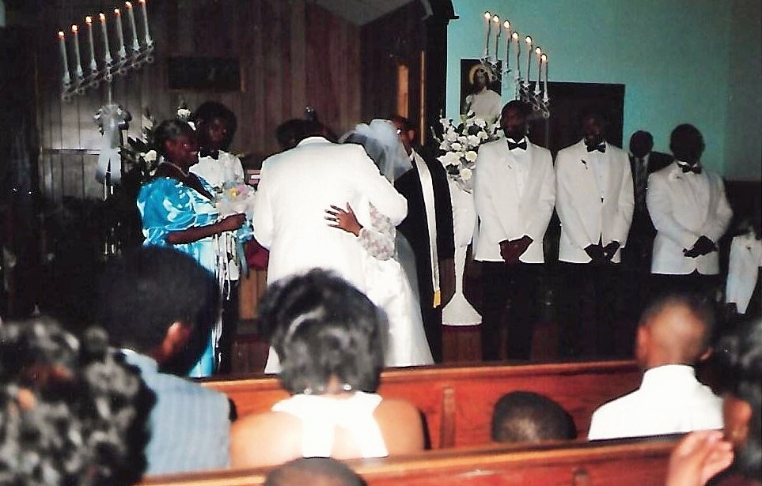
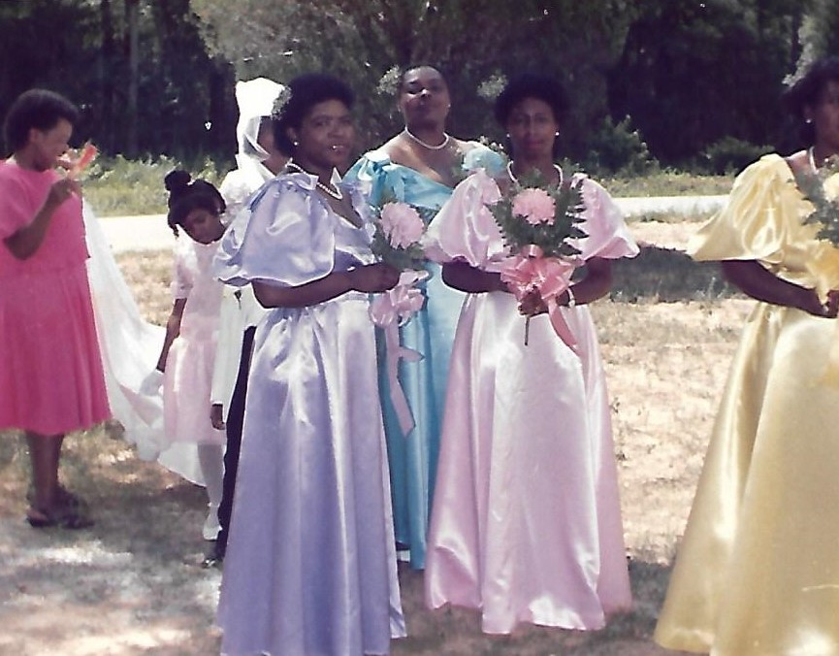
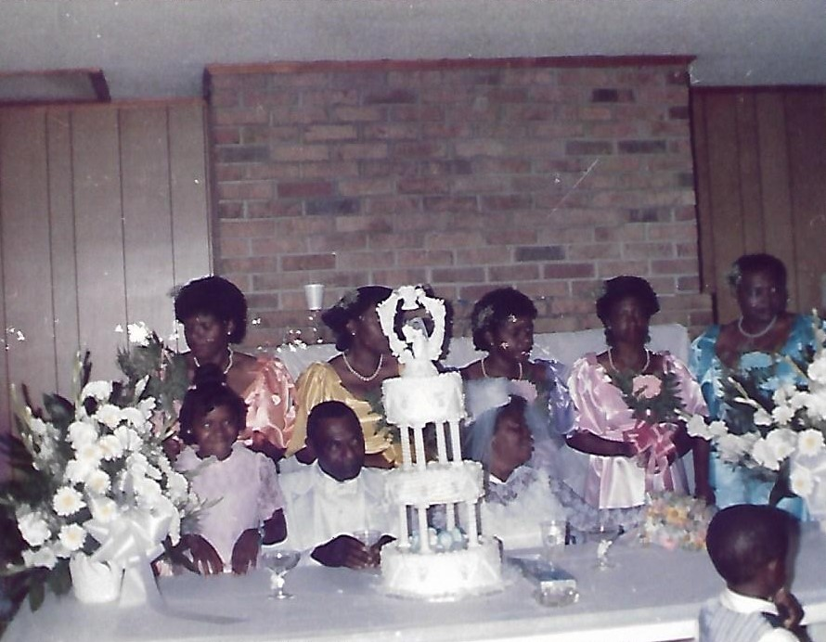
more Wedding Photos

Slide 10
Glamour Girl

Slide 11
Pretty in Red 1995

Slide 12
Just Hanging Out In The Yard

Slide 13
Church Lady

Slide 14
Sassy at church

Slide 15
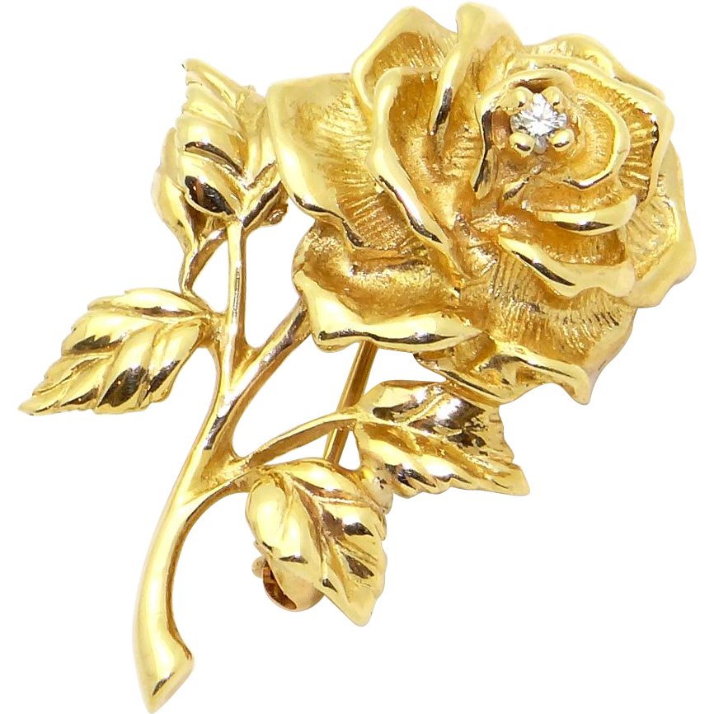
Another Church Debut

Slide 16
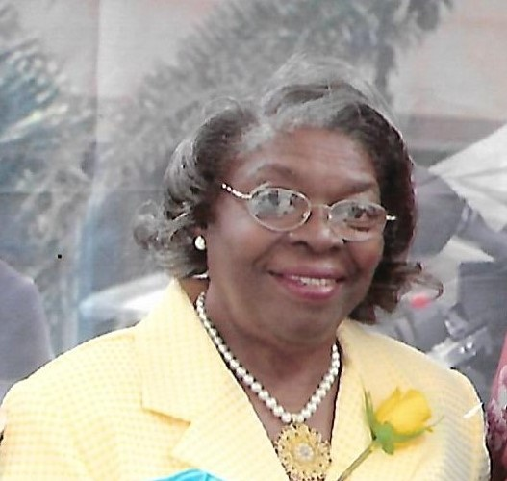
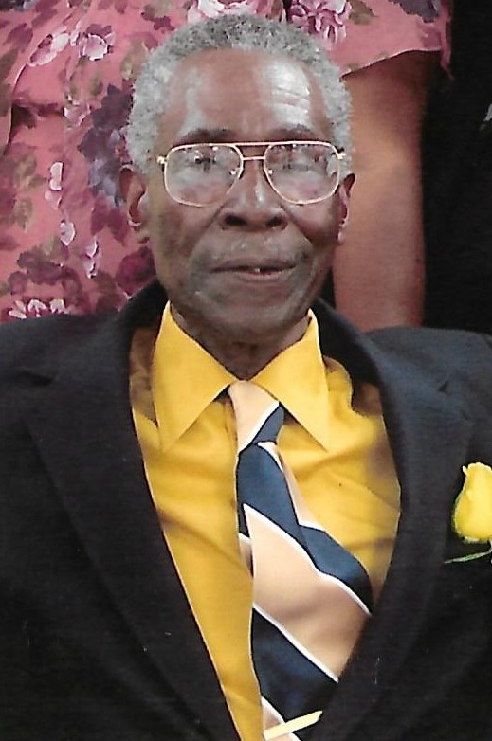
Fields Family Reunion 2007

Slide 17
Leading Ladies Tea 2016

Slide 18
SEWARD FAMILY REUNION 2017

Slide 19
Dressed in Deaconess Attire For Communion Sunday (1/28/18)
Thank
You
For
Your Service
God Bless You

